Slide 1
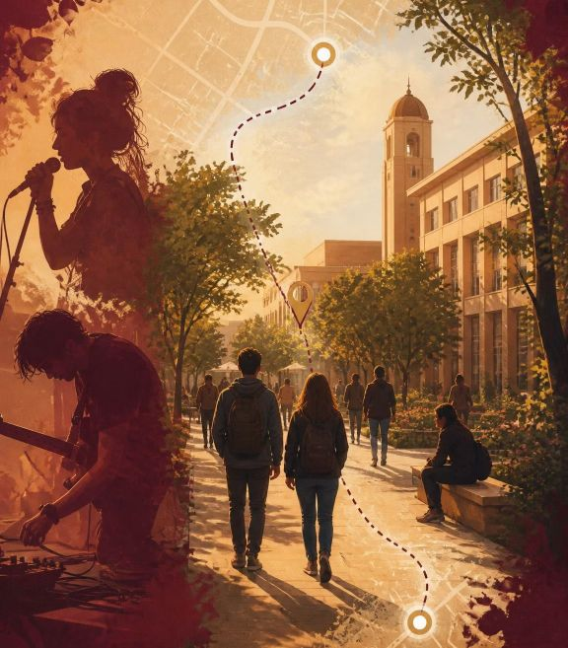
DD LPU HACKATHON · WAYFINDING PROTOTYPE
LPU CAMPUS WAYFINDER
Lost between
buildings?
SEARCH · FILTER · ARRIVE
LPU Campus Wayfinder turns campus uncertainty into one searchable visual answer.
LOVELY PROFESSIONAL UNIVERSITY, PHAGWARA

Slide 2
THE TENSION
Finding one place should not feel like a scavenger hunt.
Orient quickly
Make knowledge visible
LEAD WITH THE USER
Students, visitors, and first-time attendees need a fast way to understand where they are going.
The prototype turns scattered location knowledge into one searchable visual layer.
Not the feature list.
Start with the uncertainty, then show the calm interaction that resolves it.

Slide 3
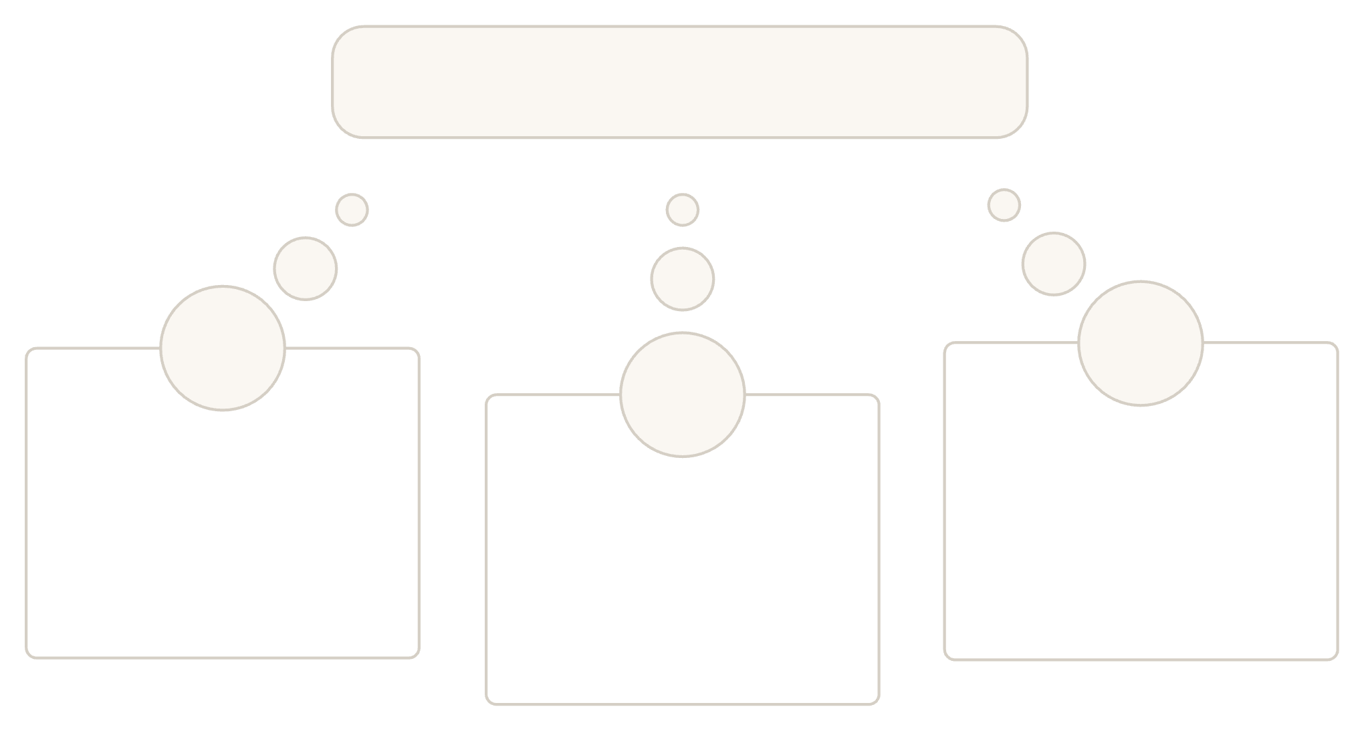



01 / THE MOMENT BEFORE MOVEMENT
Campus Map Signal
Every campus visit starts with a moment of uncertainty.
Student Block Finder
Newcomer Nearby Info
Locate classroom quickly
Visitor Gate Guide
See amenities around
The product meets different needs with the same calm, visual interaction.
Find gate or office

Slide 4
02 / THE INTERACTION MODEL
One map. Three moves. A clearer campus.
Reduce the time between “Where is it?” and “There.”
Search
Select
Find a block, hostel, gate, or venue.
Fly straight to the place with a focused popup.
Filter
Focus the campus by category.

Slide 5
03 / THE DEMO MOMENT
The demo is the product story.
CAMPUS SEARCH
●
One judge. One destination. One clear next step.
Block 32 ⌕
Block 32
Start with a judge searching “Block 32”.
Let the map fly to the selected building.
Keep the sidebar card, marker, and popup focused on the same destination.
End with the user seeing one clear next step instead of a crowded map.
Block 32
Academic Block
Academic Block
Selected destination
Selected destination
Map focused on one clear next step.
MAKE THIS THE FIRST MAP-LED WOW MOMENT.

Slide 6
04 / INTERFACE ANATOMY
One interface keeps the right things in view.
CHOOSE · LEFT
UNDERSTAND · RIGHT
READ AT A GLANCE
Sidebar
Map
Legend
Search, filters, and readable place summaries keep the decision close at hand.
Spatial context without asking the user to decode the whole campus.
Marker colors explain categories before the user needs to read every label.
CLEAR VISUAL HIERARCHY: CHOOSE ON THE LEFT, UNDERSTAND ON THE RIGHT.

Slide 7
13 PLOTTED LOCATIONS
6 CATEGORIES
One campus index
One shared definition
05 / PROTOTYPE STRUCTURE
The prototype turns campus complexity into a usable index.
Searchable places become visible, named, and selectable.
Category filters update both the list and map markers together.
SIDEBAR CARDS
Readable summaries
FOCUSED RESULTS
Quick decisions
Search results stay limited to the most relevant matches.
Each interaction keeps the list and the map aligned around the same destination.
Every location carries a name and one-line description.

Slide 8
06 / CATEGORY LANGUAGE
Six categories make the map feel legible.
Academic Block
Hostel
Food & Dining
Learning spaces and lecture buildings.
Residential destinations.
Everyday stops.
Sports
Admin / Gate
Other
Active spaces.
Arrival and official tasks.
Venues such as the Open Air Theatre.
COLOR, LABEL, AND MARKER GIVE THE MAP ONE SHARED VISUAL KEY.

Slide 9
07 / SEARCH LOOP
Search turns a campus into a direct answer.
Keep the story on the search-to-destination loop, not implementation detail.
Type
Go
Enter a place name in the search field.
Select one result to move the map and open its context.
Match
See the most relevant results in a compact list.

Slide 10
THE PROMISE · FROM SEARCH TO ARRIVAL
Less time searching. More time getting there.
SEE THE WHOLE CAMPUS
GO STRAIGHT TO WHAT MATTERS
ACADEMIC
FOOD
HOSTEL
ACADEMIC
FOOD
HOSTEL
●
●
●
●
ADMIN / GATE
SPORTS
OTHER
ADMIN / GATE
SPORTS
OTHER
●
●
●
FILTER ONCE. THE MAP AND MARKERS MOVE WITH YOU.
START BROAD. KEEP THE CAMPUS IN VIEW.
Search
Turn a campus question into a place.
Filter
Reduce the noise without losing the map.
Go
Keep the next step visible from search to arrival.
One clear answer
One visual language keeps every destination easy to recognize.
A CLEARER CAMPUS STARTS WITH A CLEARER NEXT MOVE.
LOVELY PROFESSIONAL UNIVERSITY, PHAGWARA
THANK YOU.

Slide 11
LPU HACKATHON · WAYFINDING PROTOTYPE
Thank you
Here’s to making every campus destination easier to find.
LOVELY PROFESSIONAL UNIVERSITY · PHAGWARA

